Slide 1
Utilizing AI for Face Recognition in KRG: How We Actually Did It
Dr. Polla Fattah
Chief Software Engineer, SmartGate Company
Lecturer, Salahaddin University-Erbil

Slide 2
Introduction
Background and History: Limitations & Inventions
Implementation
KNS: Kurdistan Notary System
KSS: Kurdistan Security System
KSC: Kurdistan Surveillance Cameras
AI Techniques
Optical Character Recognition
Object Detection
Face Recognition System
License Plate Recognition
2

Slide 3
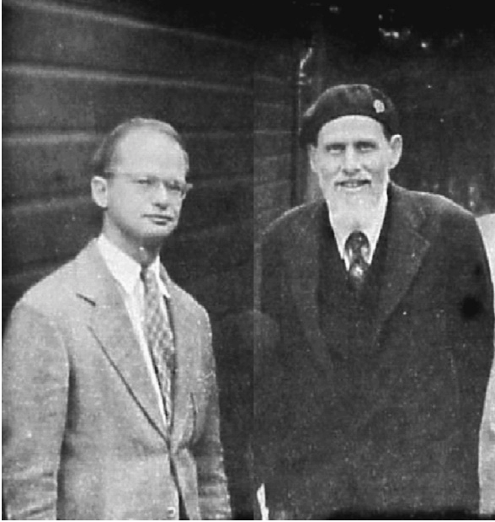
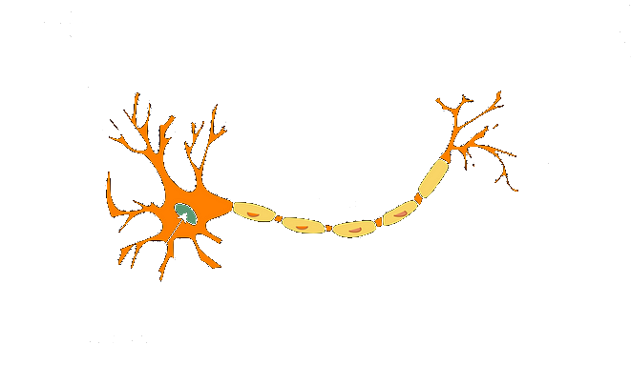

Artificial Neuron
In 1943 McCulloch and Pitts laid the early groundwork for artificial neural networks.
They introduced a simplified computational model of a biological neuron.
3
Notes:
"A Logical Calculus of the Ideas Immanent in Nervous Activity.“

Slide 4
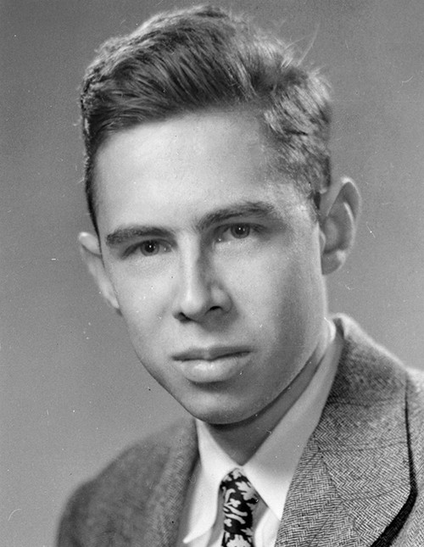
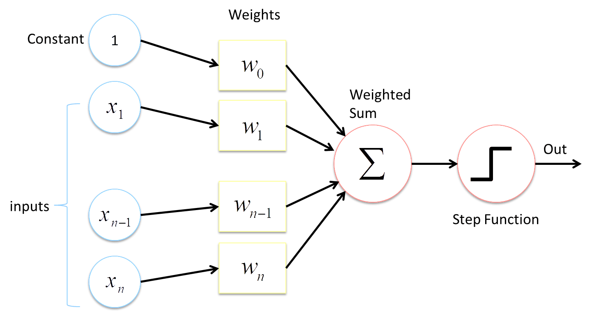
Perceptron
The first artificial neural network, called the Perceptron, was developed by Frank Rosenblatt in 1957.
Frank Rosenblatt
4
Notes:
Rosenblatt's goal was to create a machine capable of learning from experience,
It was a single layer neural network
Multilayer Neural Network
70s-80s
Recurrent Neural Network and LSTM

Slide 5
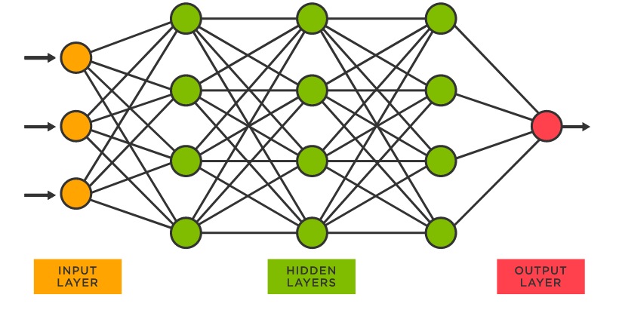
Limitation with Neural Network
To have a better NN System you need more neurons and deeper networks BUT:
Training Time. Specially matrix multiplications
Convergence.
5
Notes:
There were problems with NNs
Two huge problems

Slide 6
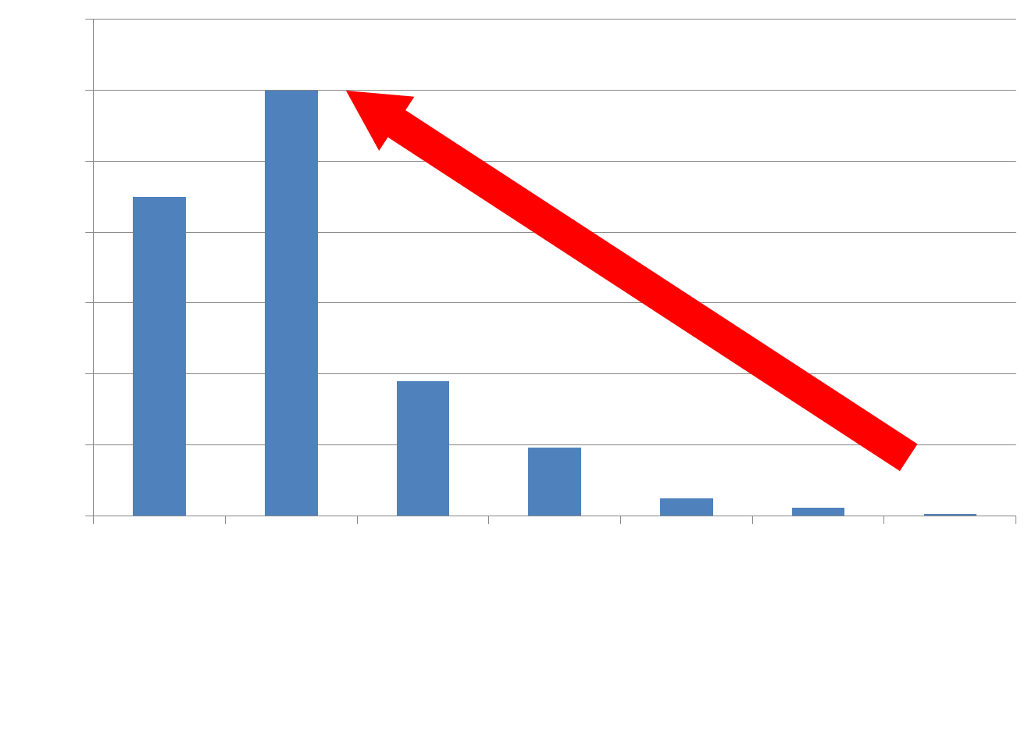
GPU
Nvidia’s GeForce 256, announced in 1999, was the world's first-ever GPU.
6

Slide 7
Matrix Multiplication
7

Slide 8
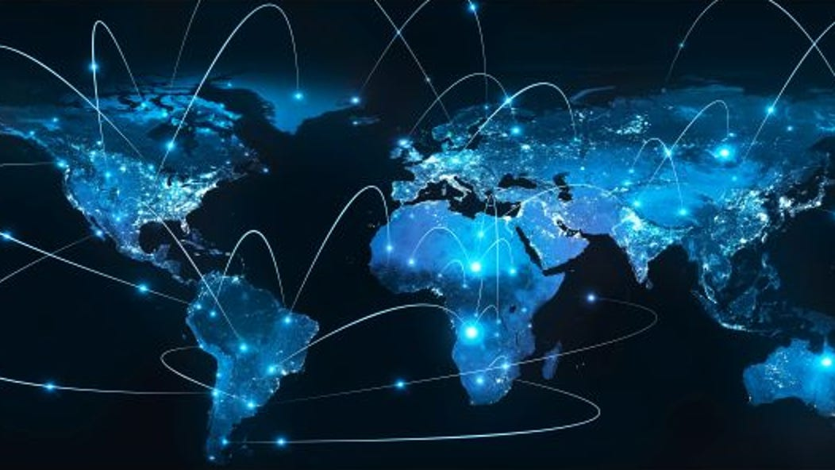
Internet
1969: ARPANET, is established by the U.S.
1989: Tim Berners-Lee develops the World Wide Web (WWW).
1998: The dot-com boom reaches its peak.
Early 2000s: Social media platforms such as Facebook and Twitter emerge.
Today: Internet of Things (IoT).
8

Slide 9
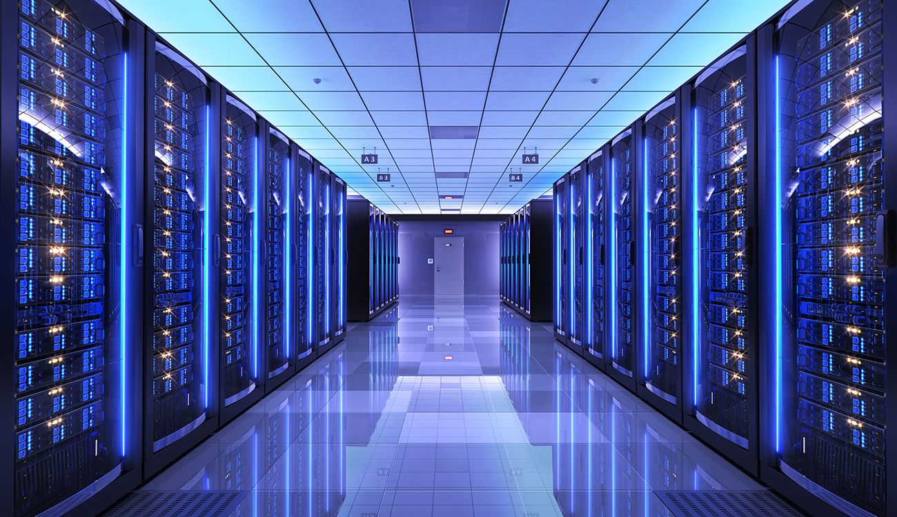
Data
The total amount of data on the internet was approximately 44 zettabytes (44 trillion gigabytes) in 2020
9

Slide 10
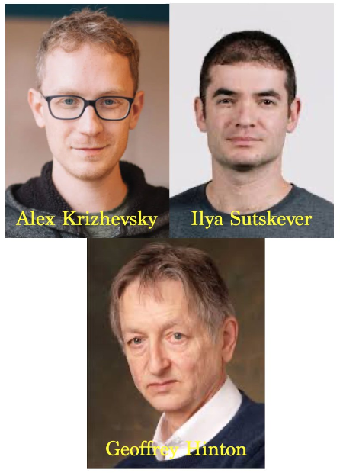
Deep Learning
10

Slide 11
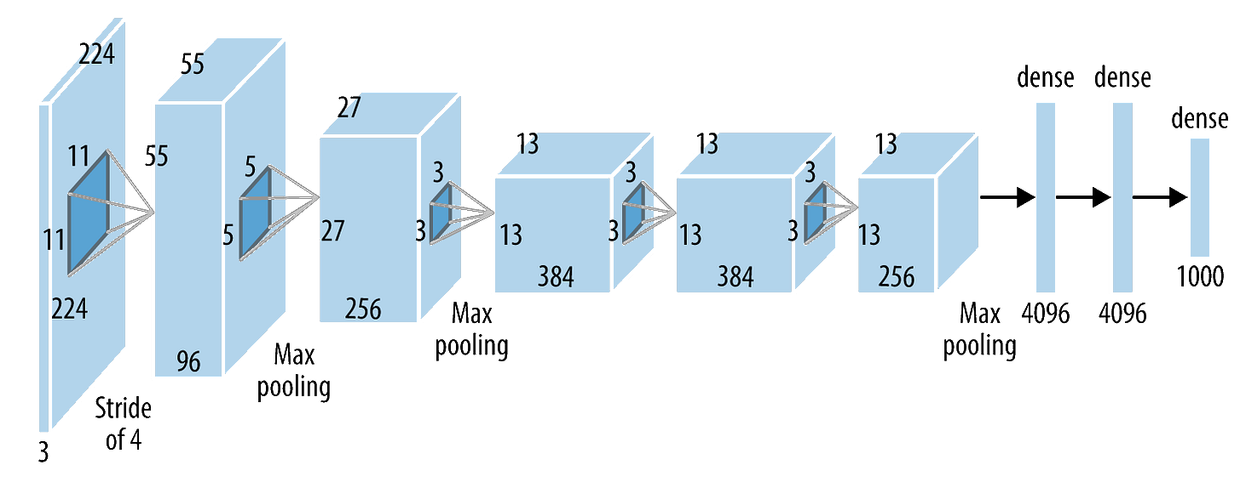
Alex-Net
Consists of eight layers in total: five convolutional layers followed by three fully connected layers.
Input size: The input size for AlexNet is 227x227x3 and 1,000 output units
Was trained on two NVIDIA GPUs, which allowed for faster training and handling of larger models.
11

Slide 12
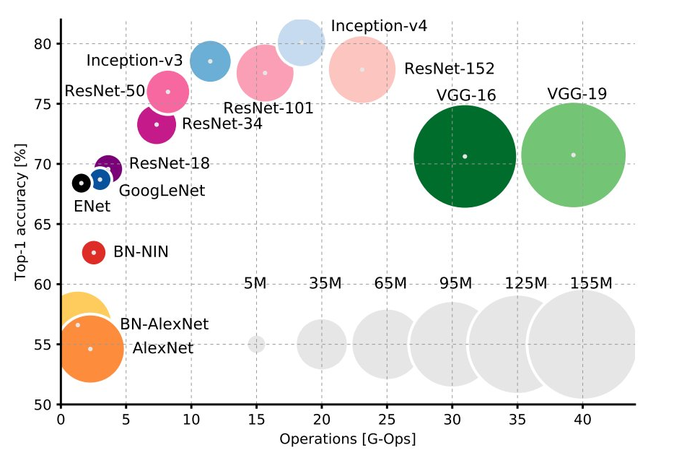
12

Slide 13
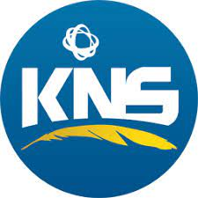


Implementations and Challenges
KNS: Kurdistan Notary System
KSS: Kurdistan Security System
KSC: Kurdistan Surveillance Cameras
13

Slide 14
Kurdistan Notary Stem
14

Slide 15
Kurdistan Notary System
Total of 65 offices around Kurdistan
With thousands of visitors each day
Currently nearly quarter of million records in each large office
Huge pressure on the government and the system to streamline the transactions.
Data entry time is precious.
Too many data to be entered
15

Slide 16
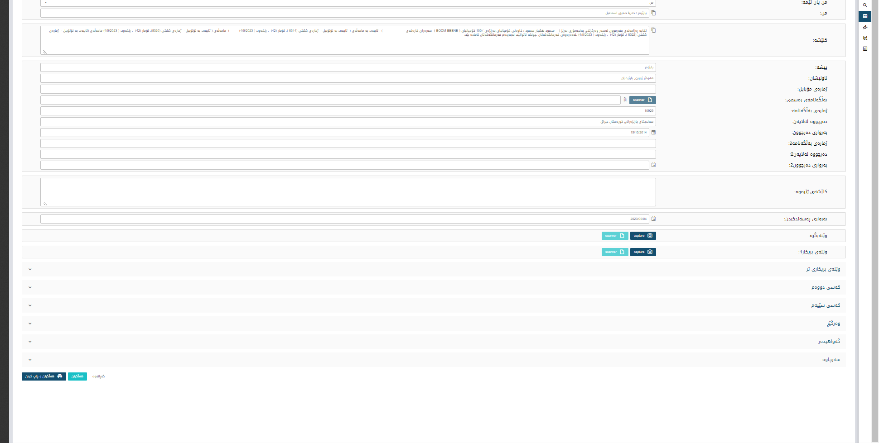
Kurdistan Notary System
16

Slide 17
Tesseract
Tesseract OCR (Optical Character Recognition)
Originally created by Hewlett-Packard (HP) in the 1980s and 1990s,
Google has been actively developing and maintaining it since 2006.
The engine is designed to recognize and extract text from images.
17

Slide 18
Tesseract
Preprocessing: Before OCR, it is often necessary to preprocess the input images to improve recognition accuracy.
Layout analysis: Tesseract can analyze the layout of text within an image, detecting paragraphs, columns, and other text structures.
Character recognition: Tesseract uses LSTM-based neural networks to recognize individual characters in the input image.
Postprocessing: After character recognition, Tesseract performs postprocessing steps, such as spell checking.
18

Slide 19
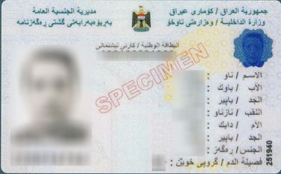
Tesseract Training
19
Notes:
90%

Slide 20
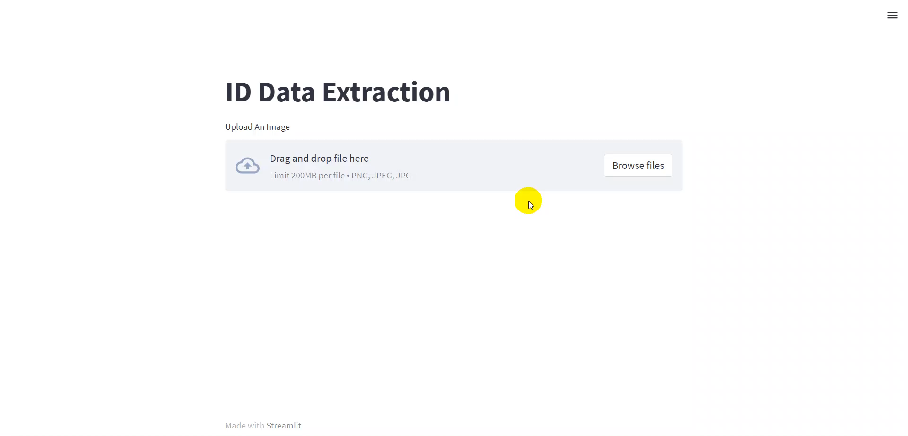
Tesseract Training
20

Slide 21
Face Recognition
FaceNet: Introduced by researchers at Google in 2015, FaceNet uses a deep convolutional neural network (CNN).
VGGFace and VGGFace2: Developed by researchers at the University of Oxford's Visual Geometry Group, the VGGFace and VGGFace2 architectures are based on the VGG CNN architecture.
ArcFace: Proposed by researchers at the Institute of Automation, Chinese Academy of Sciences, ArcFace introduces an additive angular margin loss function to improve the discriminative power of face embeddings.
DeepFace: Developed by researchers at Facebook AI, DeepFace is a CNN-based face recognition system that employs a nine-layer neural network architecture.
21

Slide 22
face_recognition library by Adam Geitgey
Face detection: The library first detects faces in the input image using the Histogram of Oriented Gradients (HOG) based face detector or an optional CNN-based face detector from the dlib library.
Facial landmarks detection: For each detected face, the library identifies 68 facial landmarks using the pre-trained dlib's facial landmark detector.
Face alignment: Using the detected facial landmarks, the library aligns the face to a canonical pose by performing affine transformations (scaling, translation, and rotation).
Face encoding: The aligned face is then passed through the pre-trained dlib's face recognition model (ResNet-34). This deep CNN generates a 128-dimensional face embedding (or encoding) that represents the unique features of the face.
Face recognition/comparison: The library provides functions to compare face encodings by calculating the Euclidean distance between them.
22

Slide 23
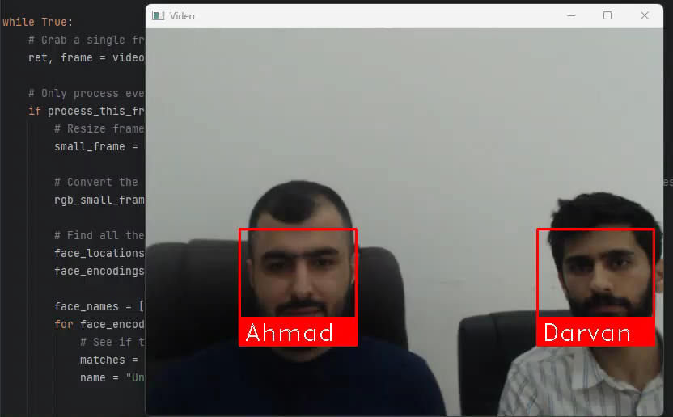
Face Recognition
23

Slide 24
Face Recognition Deployment
The model is large.
It is deployed on the server side
Clients can make request calls for the API which returns back the identified faces as records
24

Slide 25
Kurdistan Security System
25

Slide 26
Kurdistan Security System
The system is responsible for issuing residency permits of Iraqis who want to live in Kurdistan.
Includes all checkpoints of the KRG
Main offices in the large cities
Selected Police stations in the towns
26

Slide 27
Kurdistan Security System
They are implementing OCR and face detection as well.
A parallel system which contains black list that they do not want to enter KRG
The integration between these two systems was difficult as each one of them are using different character set for Kurdish language
They are not necessary have the photos.
27

Slide 28
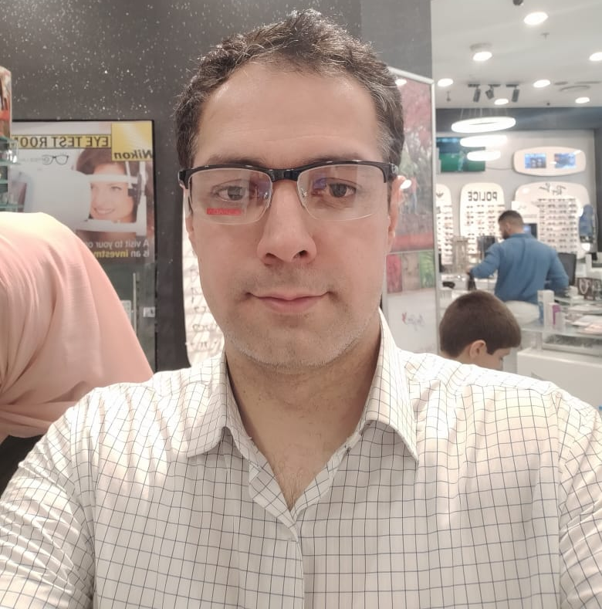
Kurdistan Security System
Black Listed 93.6%
28

Slide 29
Kurdistan Surveillance Cameras
29

Slide 30
Kurdistan Surveillance Cameras
Object Tracing
Face Detection
License Plate Recognition
30

Slide 31
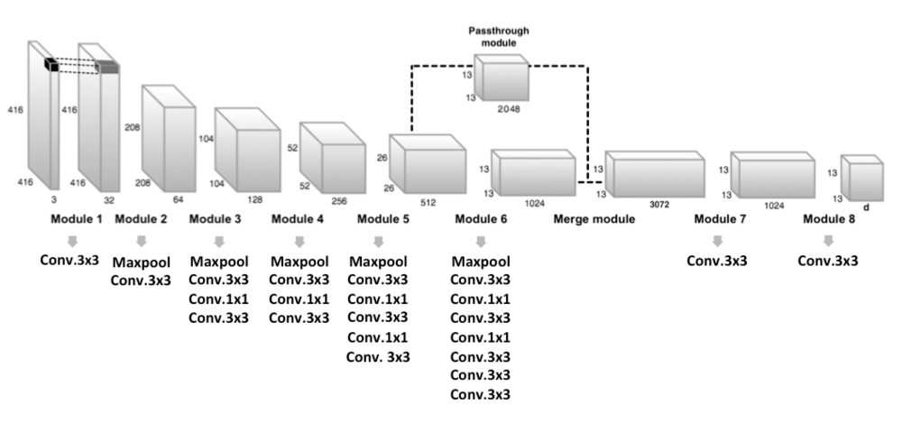
Object Detection
YOLO was first introduced by Joseph Redmon, Santosh Divvala, Ross Girshick, and Ali Farhadi in a 2016 paper titled "You Only Look Once: Unified, Real-Time Object Detection."
Is a real-time object detection system that employs (CNN) to simultaneously predict multiple bounding boxes and class probabilities for those boxes.
31

Slide 32
APLR
The ALPR-Unconstrained a project created by Sergio Montazzolli
It to provide an Automatic License Plate Recognition (ALPR) system that can handle unconstrained scenarios.
The ALPR-Unconstrained system is based on deep learning techniques, utilizing a combination of You Only Look Once (YOLO) and Optical Character Recognition (OCR) to detect and recognize license plates.
32

Slide 33
APLR Components
Vehicle detection: The system first detects vehicles in the input image using a pre-trained YOLOv2 model.
License plate detection: Once vehicles are detected, the system proceeds to identify license plates within the vehicle bounding boxes using another pre-trained YOLOv2 model, specifically trained for license plate detection.
OCR for character recognition: the system uses an OCR model to recognize the individual characters on the license plates.
Post-processing: post-processing steps to filter out false positives, refine character segmentation, and correct potential recognition errors.
33

Slide 34
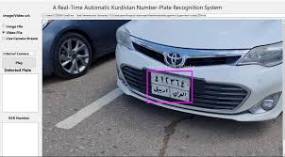
APLR In Action
34

Slide 35
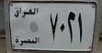
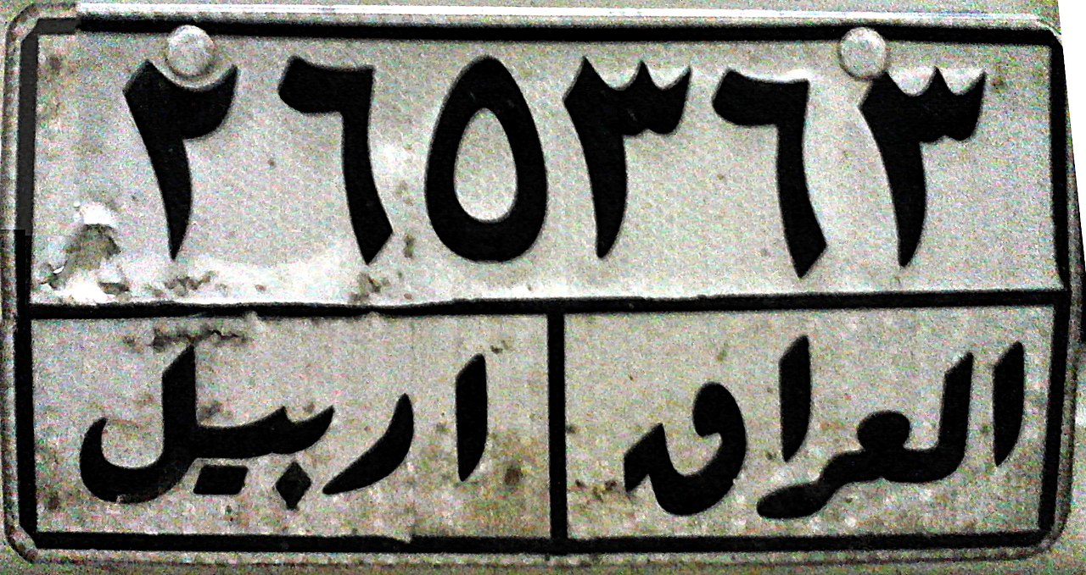
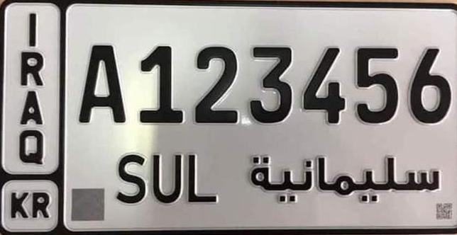
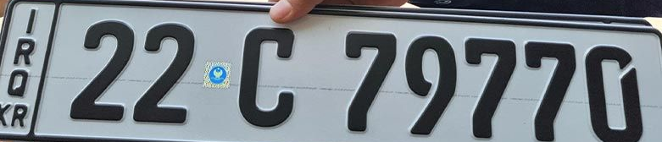
APLR In Action
35

Slide 36
KSC System requirements
CPU:
Intel Core i7 or i9 processor with 8 or more cores.
Clock speed of at least 3.5 GHz or higher.
12 MB or more of L3 cache.
GPU:
NVIDIA GeForce GTX or RTX series, or AMD Radeon RX series GPU.
8 GB or more of GDDR5 or GDDR6 memory.
At least 2560 CUDA cores or 2304 Stream processors.
Storage requirements for each camera captures video at a resolution of 1080p and a frame rate of 30:
1 month of video will take up approximately 1.8 TB of storage space per camera.
36

Slide 37
Next
Now We are living the long waited future of real automation and task delegation
Ideal time to specialize and refine one's career
Notable shortage of AI Engineers and Data Scientists
Particularly high demand for tackling localized problems and language-specific challenges.
37

Slide 38

38

